Slide 1
Complex Logic, Introduction to Wrapper Class, and Composition

Slide 2

Weekly Announcements!
TODO Reminders:
Reading 8 (zybooks) – you should have already done that ☺
Lab 05 – self explanation needs to be done in lab
Reading 9
Lab 06
Reading 10 (zybooks)
Keep practicing your RPAs in a spaced and mixed manner ☺

Slide 3
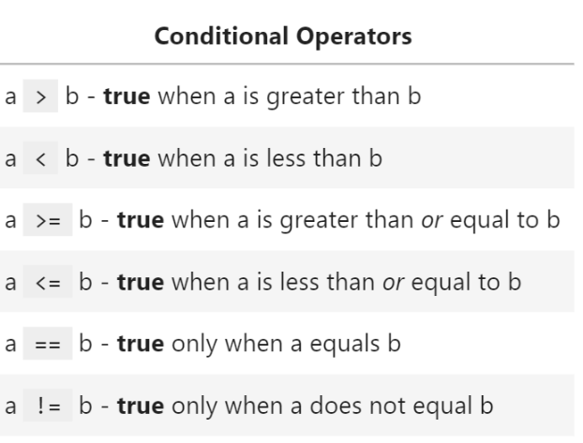
Review: Conditionals Operators

Slide 4
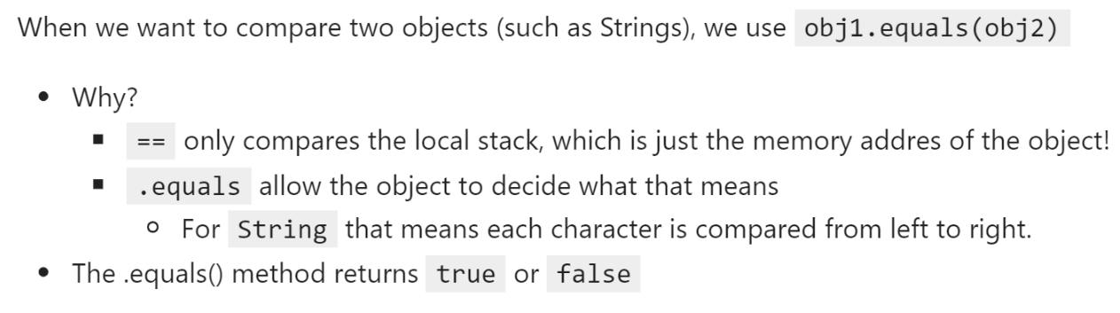
Review: Conditionals Operators
How can we combine different conditions?
Use Logical Operators to do Complex Conditional!

Slide 5
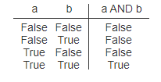
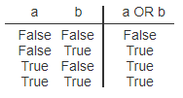
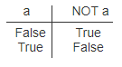
Complex Conditionals
All must be true
At least one must be true
Negates the original condition

Slide 6
Logical Operators
Logical and - &&
All must be true
int puppyCounter = 10;
if(puppyCounter > 5 && puppyCounter < 10) {
System.out.println(“Yay, puppies”);
}
Logical or - ||
Any statement can be true
Continues checking even if false
String cmd = “exit”;
if(cmd.contains(“x”) || cmd.contains(“X”)) {
System.out.println(“Goodbye”);
}

Slide 7
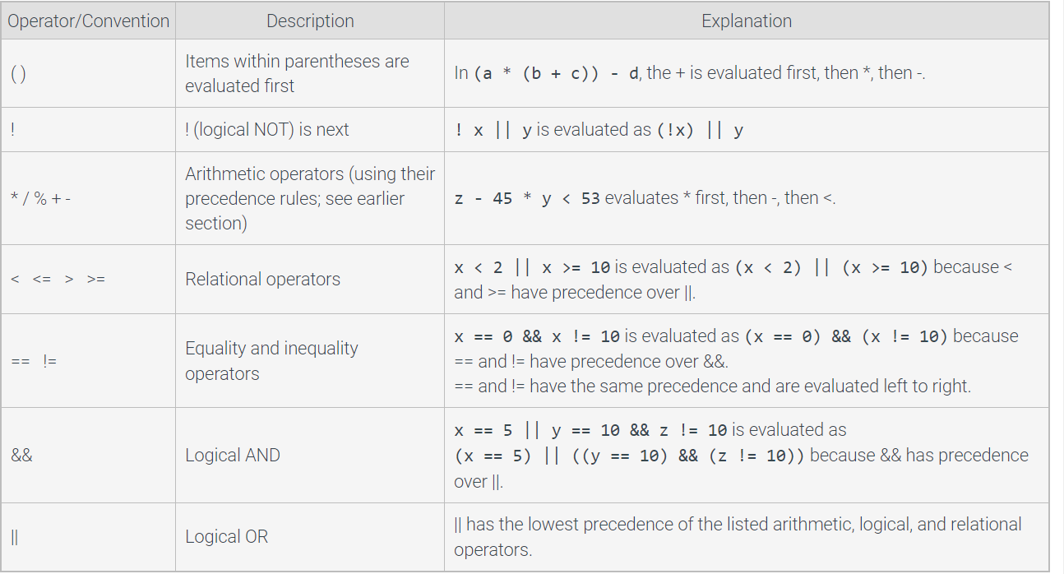
Precedence rules for arithmetic, logical, and relational operators

Slide 8
Logical Operators – In Class Activity - Attendance
Only compare true or false
Every statement on each side must evaluate as true or false to use the logical operation.
Mark valid or invalid for the statements below and explain your answer:
A)
!((4 + 1) < (2 * 0))
A)
B)
10/2 > 5 || (3 + 4) < 10 && true
C)
10 > 5 && 10

Slide 9
Review
Conditional Operators
Compare primitives
Objects need methods
equals
equalsIgnoreCase
Logical Operators
Compare boolean only – true and false
As such, everything must evaluate to true or false before they are used

Slide 10
Wrapper Class
A primitive type variable directly stores the data for that variable type, such as int, double, or char.
A reference type variable can refer to an instance of a class, also known as an object.
Wrapper classes that are built-in reference types that augment the primitive types
Meaning that every primitive type has a class associated which provides methods to be used

Slide 11
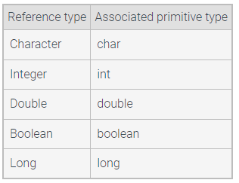
Wrapper Class
Example: using Integer.parseInt
public class IntegerParseIntExample { public static void main(String[] args) { int decimalExample = Integer.parseInt("20"); int signedPositiveExample = Integer.parseInt("+20"); int signedNegativeExample = Integer.parseInt("-20"); System.out.println("Value = "+decimalExample); System.out.println("Value = "+signedPositiveExample); System.out.println("Value = "+signedNegativeExample); } }

Slide 12
Composition
A composition in Java between two objects associated with each other exists when there is a strong relationship between one class and another.
For example, one class has an attribute that is an object of another class.

Slide 13
Composition: Example
public class Library { private Book book1; private Book book2; private Book book3; public Library(){ book1 = null; book2 = null; book3 = null; } public boolean addBook(Book book){ if(book1 != null && book2 !=null && book3 != null) return false; if(book1 == null) book1 = book; else if(book2 == null) book2 = book; else if(book3 == null) book3 = book; return true; } public String toString(){ String msg = ""; if(book1 != null) msg += book1 + "\n"; if(book2 != null) msg += book2 + "\n"; if(book3 != null) msg += book3 + "\n"; if(msg.equals("")) msg = "No books in the library!"; return msg; } }
Instance variables
public class Book { // Instance variables --> attributes private String title; private String author; // Constructor of this class public Book(String title, String author) { this.title = title; this.author = author; } public String toString(){ return "Title: " + title + " Author: " + author; } }
Constructor

Slide 14
Composition: Example
public class AppLibrary { public static void main(String args[]){ Library lib = new Library(); System.out.println(lib.toString()); Book b1 = new Book("Death on the Nile", "Agatha Christie"); if(lib.addBook(b1)) System.out.println("Book added!"); else System.out.println("No more space in the library!"); System.out.println(lib.toString()); } }

Slide 15
Lets take a look on Lab 05
First step
Understand where wrapper class and composition were used
Second step
Understand what the classes provided are doing to be able to implement the method addRow – this is the only method you need to implement
The TAs will provide additional help tomorrow during your lab time
https://github.com/CSU-CompSci-CS163-4/Lab05LogicalGarden

